Slide 1
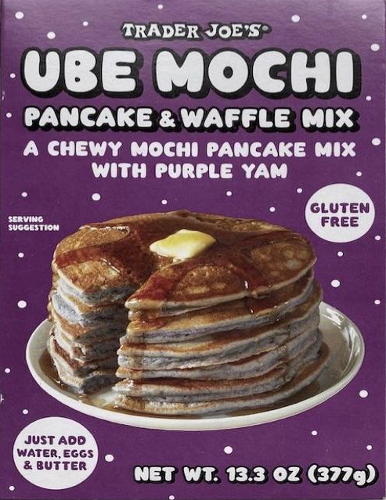
Hybrid Neural Network with Qiskit and Pytorch
IBM Qiskit Community Summer Jam Hackathon (North Carolina)
Hackathon Coach: Robert Loredo
Team Ube Pancake

Slide 2
Foundational Work
Qiskit Textbook: Hybrid quantum-classical Neural Networks with PyTorch and Qiskit
https://qiskit.org/textbook/ch-machine-learning/machine-learning-qiskit-pytorch.html
Implemented a quantum neural network layer of 1 qubit with 1 trainable parameter into a classical neural network for the classification between 0 and 1
Qiskit Camp Europe 2019 Hackathon: Team QizGloria
https://github.com/BoschSamuel/QizGloria
Built upon the Qiskit Textbook example and expanded to 1 qubit with 2 and 3 trainable parameters
Attempted at implementing a 2-qubit layer

Slide 3
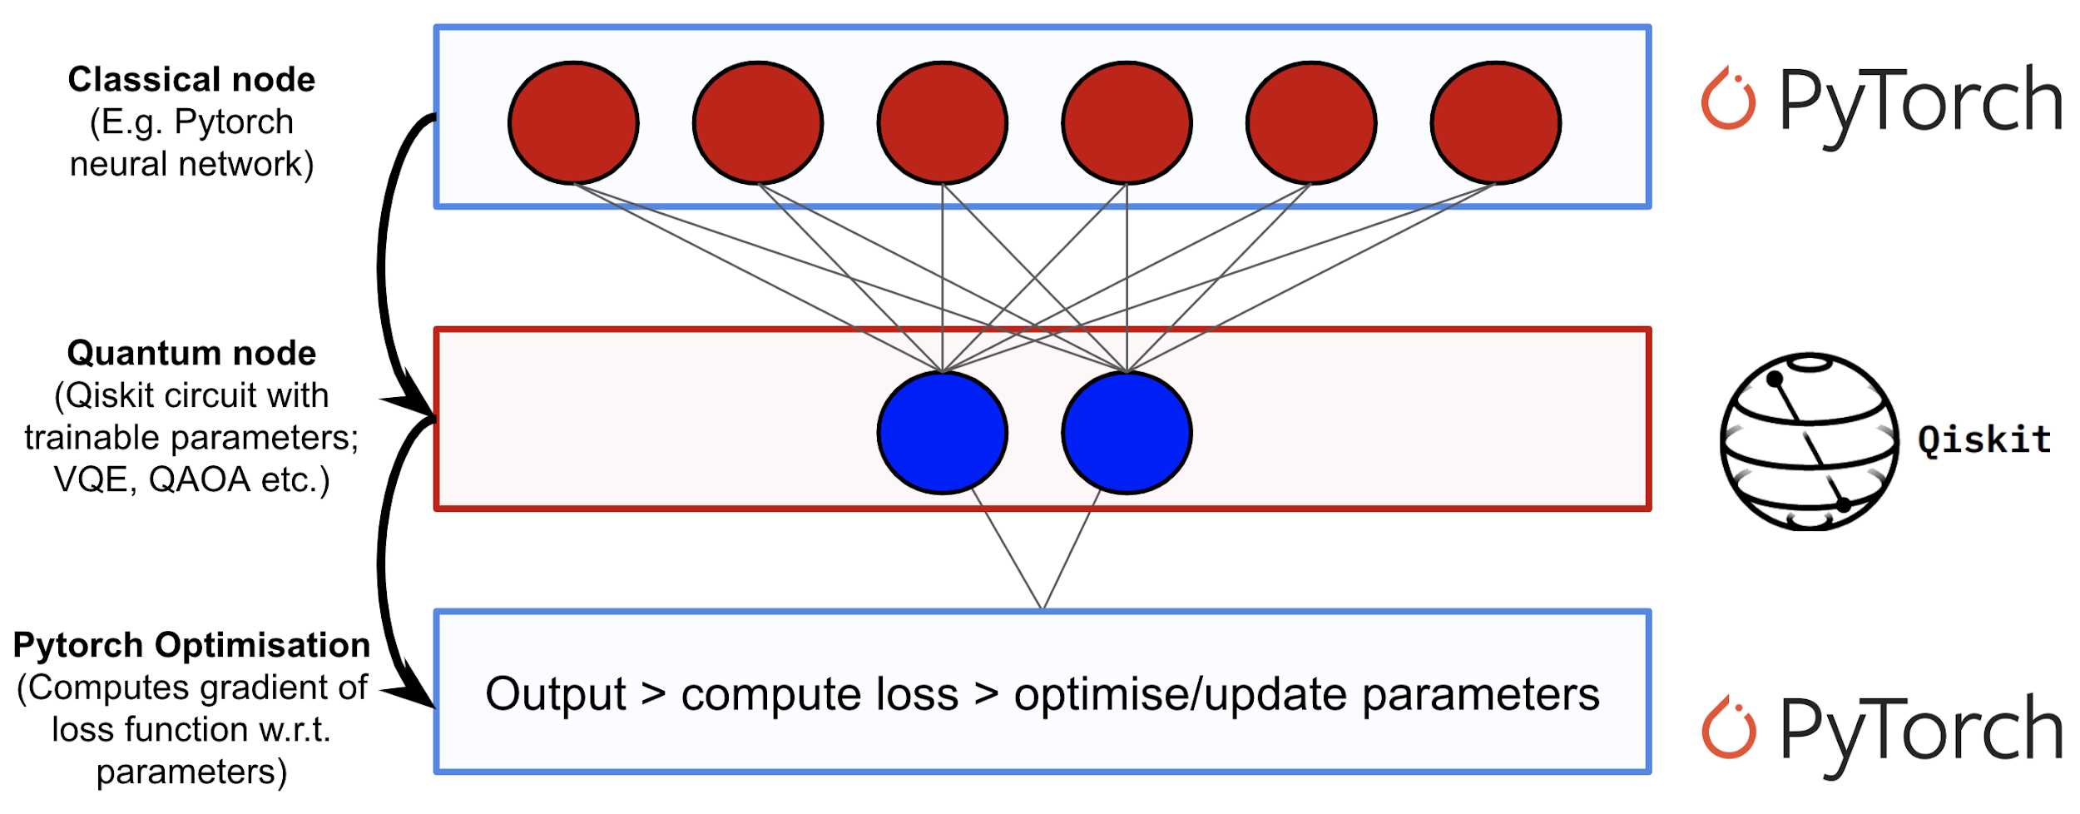
Quantum-classical Hybrid Neural Network
Reference: Qiskit Textbook Hybrid quantum-classical Neural Networks with PyTorch and Qiskit
(https://qiskit.org/textbook/ch-machine-learning/machine-learning-qiskit-pytorch.html)

Slide 4
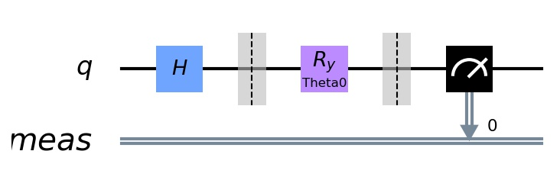
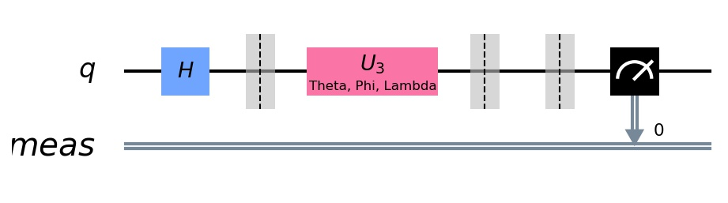
Quantum Layer Circuit
1-qubit circuit with a y-rotation that has 1 trainable parameter/qubit (ry)
1-qubit circuit with a unitary3 gate that has 3 trainable parameters/qubit (u3)

Slide 5
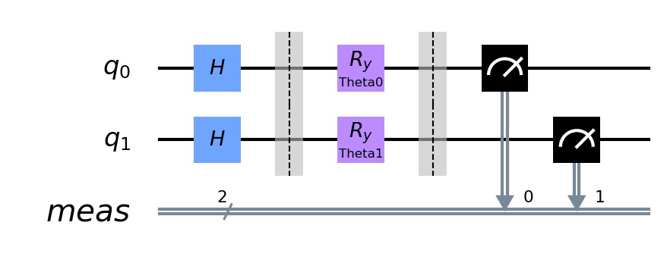
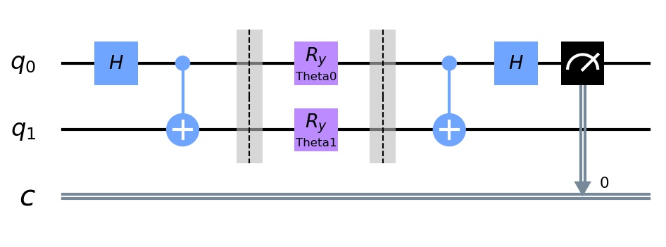
Quantum Layer Circuit
N-qubit y-rotation typed circuit with 1 trainable parameter/qubit (ryN)
Bell state circuit with n-qubit y-rotation with 1 trainable parameter/qubit (bell)

Slide 6
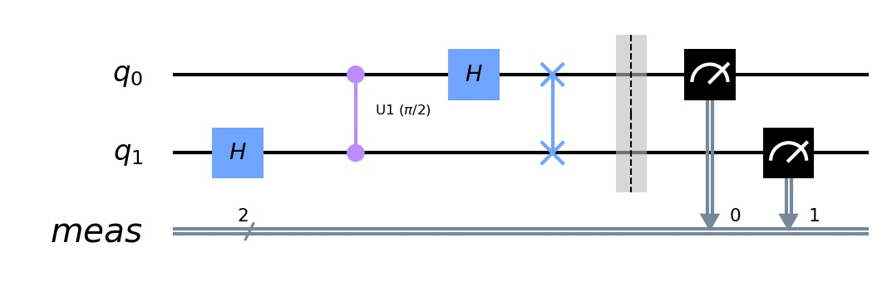
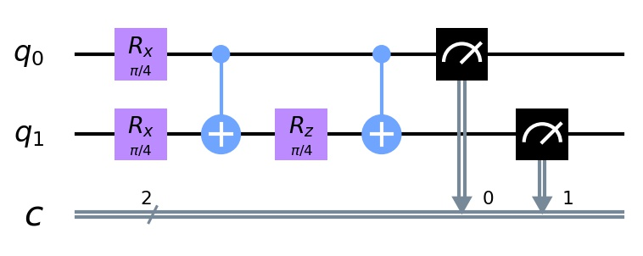
Quantum Layer Circuit (in progress)
N-qubit Quantum Fourier Transform Circuit (qft)
Qiskit Quantum Fourier Transform:
https://qiskit.org/textbook/ch-algorithms/quantum-fourier-transform.html
N-qubit QAOA Circuit (QAOA)
A Quantum Approximate Optimization Algorithm:
https://arxiv.org/abs/1411.4028

Slide 7
Result Highlights
 | TASK | BACKEND | N_QUBITS | CIRC_TYPE | ACCURACY
 | Classify 0-1 | QASM Simulator | 2 | ryN | 100%
 | Classify 0-1 | QASM Simulator | 2 | bell | 99.8%
 | Classify 0-5 | QASM Simulator | 3 | ryN | 91%
 | Classify 0-7 | QASM Simulator | 3 | ryN | 95%
 | Classify 0-9 | QASM Simulator | 4 | ryN | 86%
More results to be found in out README: https://github.com/liangqiyao990210/Quantum-Deep-Learning

Slide 8
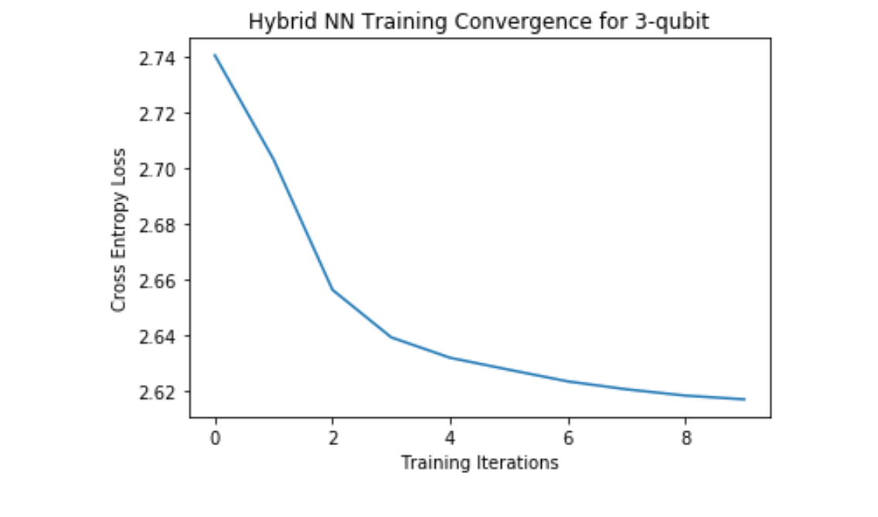
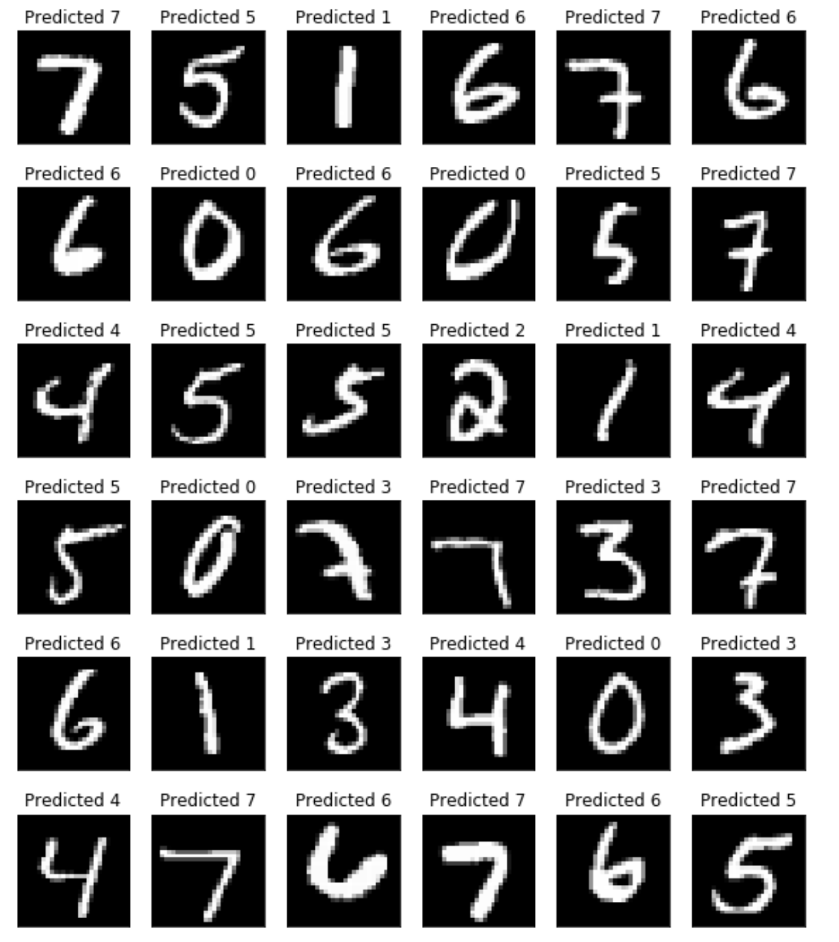
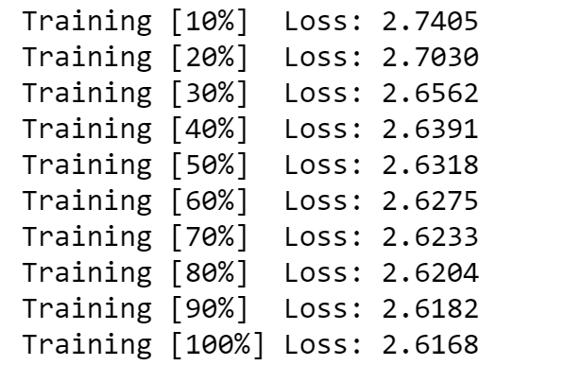

Slide 9
What we have tried and learned...
Hybrid NNs could have potential applications for NISQ devices!! (Qiskit and Pytorch)
It doesn’t seem like the more qubits we use (hence more trainable parameters), the better results we get for classifying numbers (to be investigated)
We have tried running our IBM Q Rome but it took too long…
Don’t try to run everything the night before...

Slide 10
Future Direction:
Try out different classification problems:
MNIST Fashion, Cats and dogs, etc.
Try out different circuits:
Investigate the differences between multiple parameters per single qubit versus multiple qubits each with a single parameter
Try out more complex circuits, composite circuits, entanglement-generating circuits, n-controlled unitary, etc. (in progress)
Explore suitable circuits for specific problems
Implement CUDA for GPU acceleration of training
Implement on NISQ devices (IBM quantum hardware):
Try training our neural nets on the actual IBM machine (have attempted)
Compare results from an actual hardware with that from the simulator
Implement QECCs

